Slide 1
SCM 651: Business Analytics
Week 8

Slide 2
Agenda
Review of homework #3 (Regression and Optimization)
Overview of homework #4 (Logit, Probit, Neural networks: info in week 9 videos)
Review of hands-on exercises
Group discussion of articles
What Businesses Can Learn from Sports Analytics?
Team GB: Using Analytics (and Intuition) to Improve Performance

Slide 3
Homework #3
Graph, regression, calculated sales, revenue, profit
Constrained optimization
Discussion of risks, other data which would be valuable

Slide 4
Homework #4
Logit and probit analysis (see week 9)
Moderating effects (week 7)
Final logit & probit models with interaction effects (moderating effects), prediction of outcome, sensitivity analysis
Neural network analysis
Neural network prediction model and sensitivity analysis (new material in handout in week 9)

Slide 5
Week 8 - Review
Regression Assumption #1: linearity
Violation: non-linear data
Test: RESET
Solution: transformation (logarithm, square, inverse, square root, other)
Solution technique: Box-Cox (Y), Box-Tidwell (X)
Regression Assumption #2: X variables are not correlated
Violation: multicollinearity
Test: Variance Inflation Factor (VIF)
Solution: drop variables, combine variables (Factor Analysis)

Slide 6
Week 8 - Review
Regression Assumption #3a: errors are random with constant variance
Violation: heteroscedasticity, or wedge shape to error terms in scatterplot
Test: Breusch-Pagan
Solution: transformation (logarithm, square, inverse, square root, other) or Huber regression
Solution technique: Box-Cox (Y), Box-Tidwell (X), Huber robust regression if heteroscedasticity still exists after Box-Cox (Y), Box-Tidwell (X)

Slide 7
Week 8 - Review
Regression Assumption #3b: error terms are correlated
Violation: serial correlation
Test: Durbin-Watson
Solution: adjust coefficients
Solution technique: Prais-Winsten, rho differencing, ARCH, Cochrane-Orcutt
Regression Assumption #3c: outliers
Violation: outlier influences slope of line
Test: Bonferonni test of outliers
Solution: drop outlier data points
Solution technique: Bonferonni identification of outliers (Bonferonni value < 0.05)

Slide 8
Week 8 - Review
Benford’s law
Financially reported numbers tend to start with smaller digits
Decision trees
Use entropy reduction to reduce the amount of error in the data to make a decision
Identify the most important variables in making a decision
Create a series of rules to make a decision

Slide 9
Week 8 – New Material
Corrections regression assumptions
Linearity
Box-Cox: transform the Y variable
Box-Tidwell: transform the X variable
Use of Box-Cox on scientific data
Multi-collinearity
Factor analysis
Heteroscedasticity
Huber robust regression
Serial Correlation
Prais-Winsten
Outliers
Bonferonni identification of outliers

Slide 10
Why are open-source statistical programming languages the best?
Because they R.

Slide 11
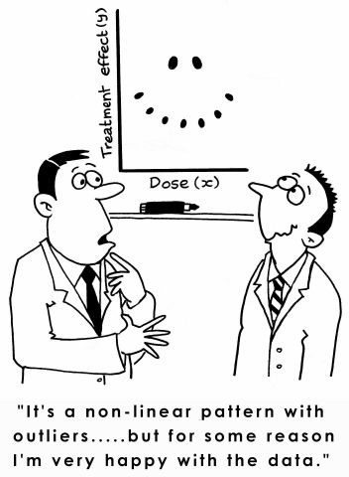
Outliers

Slide 12
Article #1: What Businesses Can Learn from Sports Analytics
What Businesses Can Learn from Sports Analytics
Describe the five key lessons of analytics in sports (give an example of each)

Slide 13
Article #1: What Businesses Can Learn from Sports Analytics
What Businesses Can Learn from Sports Analytics
Describe the five key lessons of analytics in sports (give an example of each)
Align leadership at multiple levels
Player acquisition, player payment, strategies for performance
Focus on human dimension
Individual-level game performance
Performance in context (plus/minus analysis)
Exploit locational data
NYY player acquisition based on homerun measurement
Broader ecosystem (partnerships)
Business operations, dynamic ticket pricing, digital strategy
Support “analytic amateurs”
Players becoming analytics specialists

Slide 14
Article #2: Team GB: Using Analytics (and Intuition) to Improve Performance
Team GB: Using Analytics (and Intuition) to Improve Performance
What is the value of predicting team performance? (page 2)
What is the biggest challenge? (page 2)
What are some of the barriers? (page 3)
Where is the power of the data? (page 5)

Slide 15
Article #2: Team GB: Using Analytics (and Intuition) to Improve Performance
Team GB: Using Analytics (and Intuition) to Improve Performance
What is the value of predicting team performance? (page 2)
Priorities: GB only funds sports which are likely to produce medals
What is the biggest challenge? (page 2)
Difficulty in collecting data – some sports are hard to collect
What are some of the barriers? (page 3)
Elite coaches rely on experience, rather than data
Where is the power of the data? (page 5)
Longitudinal data rather than snapshots

